Slide 1


Interview Session
John Smith, the interviewer, warmly welcomes Maya Johnson, the interviewee, to the company headquarters.

Slide 2
Purpose of the Interview
The primary goal of the interview is to assess the qualifications of candidates and determine if they are fit for the open position of Data Analyst, Web Developer and Project Manager.
Job Description
Cultural Fit
The interview aims to discuss how Maya's skills and experience align with the responsibilities outlined in the job description.
Assessing her values and work style compatibility with the company's culture is another key focus of the interview.

Slide 3
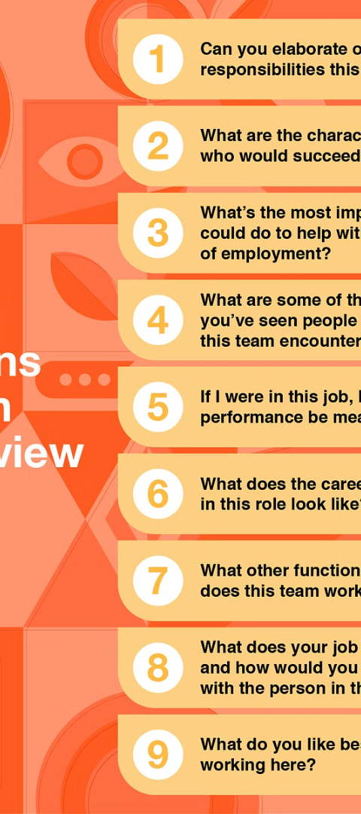
Interview Questions and Answers
John asks Maya about her previous work experiences and how they have shaped her approach to marketing strategy and execution.
1
Work Challenges
2
Innovative Campaigns
The candidates will share how they overcame challenging marketing situations in her previous roles.
The Company inquires about the candidate's involvement in creating successful and innovative projects to help the company

Slide 4
Discussion of Qualifications and Experience
Maya elaborates on her educational background, professional certifications, and hands-on experience in digital and content marketing.
1
Educational Background
The candidate describes her academic achievements and how they have contributed to the success of their previous job if any.
2
Professional Certifications
The candidate should make ready certifications as proof of qualification before the interview.
3
Hands-on Experience
The candidate provides insights into the various projects he or she has led and their outcomes.

Slide 5
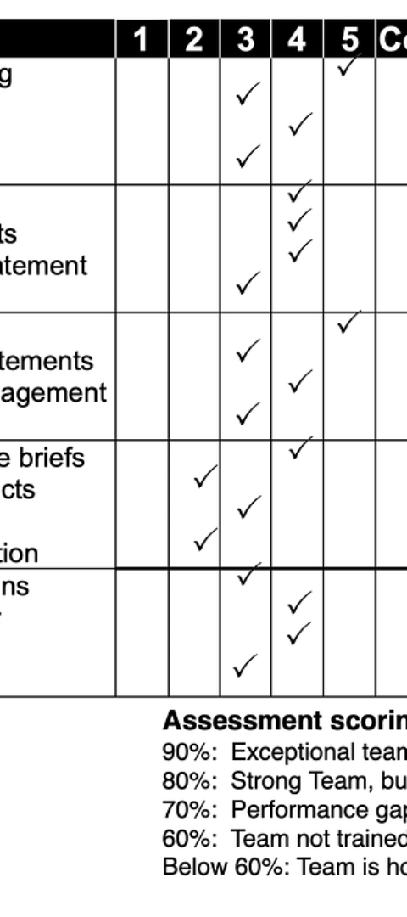
Assessment of Skills and Fit for the Position
John evaluates Maya's critical thinking abilities and her approach to problem-solving in marketing scenarios.
Problem-Solving Skills
Adaptability
John uncovers how Maya approaches and resolves complex marketing challenges.
Maya demonstrates her flexibility in adapting to changing market trends and consumer preferences.

Slide 6
Thank You and Follow-Up Communication
Maya thanks John for the opportunity and expresses her enthusiasm about the potential to contribute to the team.
24H
1W
Follow-up Email
Next Communication
Maya plans to send a follow-up email expressing her gratitude within 24 hours.
John mentions that the next communication regarding the interview outcome will occur within 1 week.

